Slide 1


Neutron Diffusion via Finite Difference Methods
Robin Newby

Slide 2
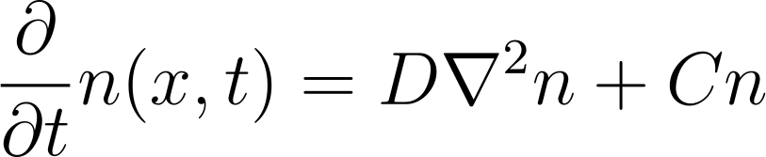
Neutron Diffusion
Simplified model for Neutron Transport
Toy model of Nuclear Material
Diffusion Term
Stimulated Creation Term
Solved via Finite Difference Methods: FTCS, LAX

Slide 3
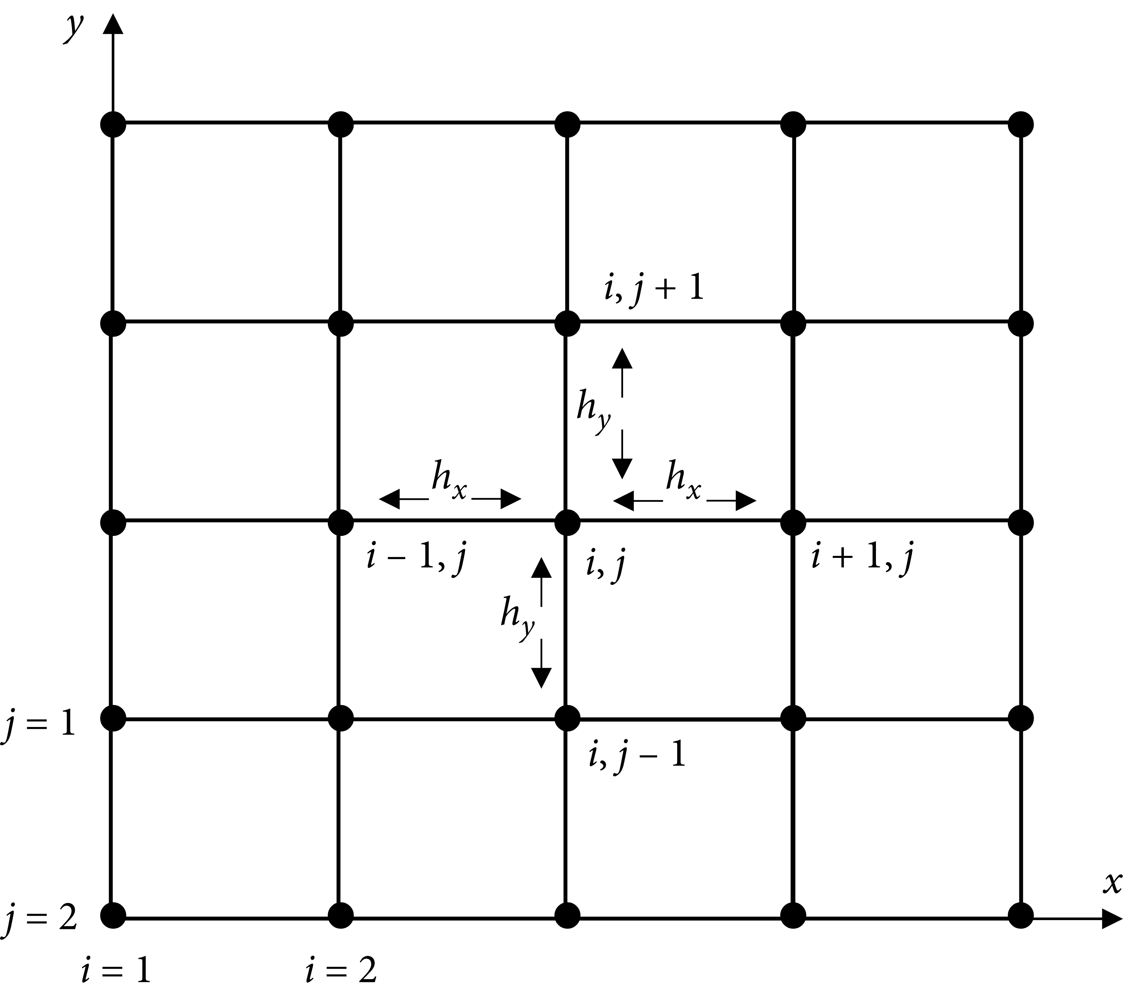
FTCS
Forward time
Centered Space

Slide 4
LAX
Replaces sampled points with the average of their neighbors
When calculating for point at (i,j), only does this averaging for the term that acts at (i,j); derivatives calculated normally

Slide 5
FTCS vs LAX
FTCS has stricter stability criteria, but is more accurate
LAX is more stable, but has diffusive behavior built in

Slide 6
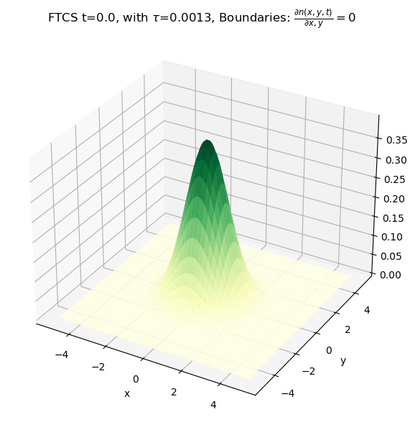
Initial Conditions
2D un-normalized Gaussian
Whoops!
Normalization irrelevant

Slide 7
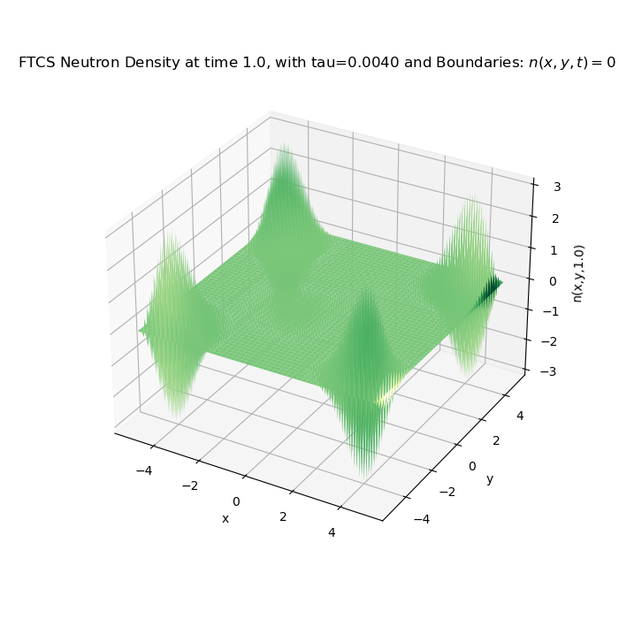
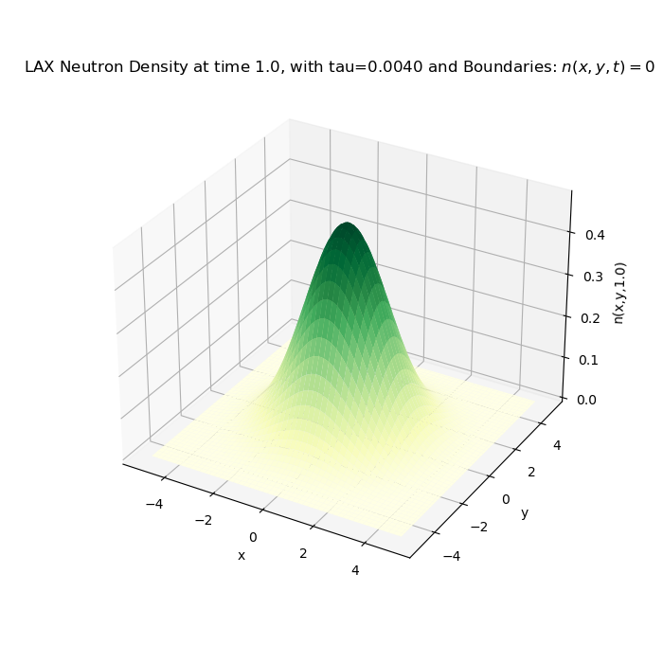
FTCS vs LAX

Slide 8
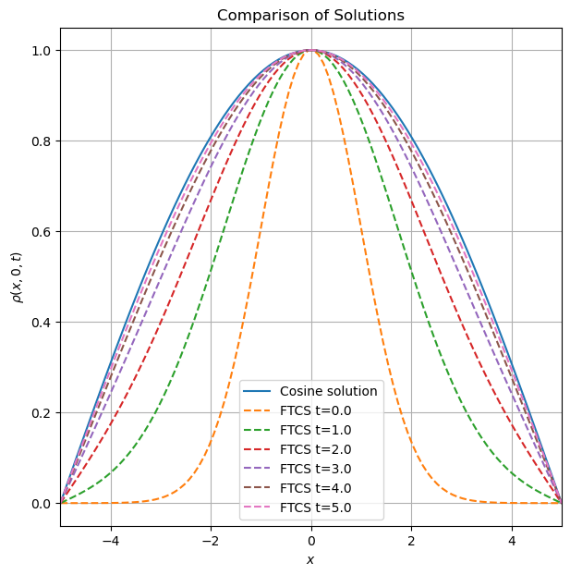
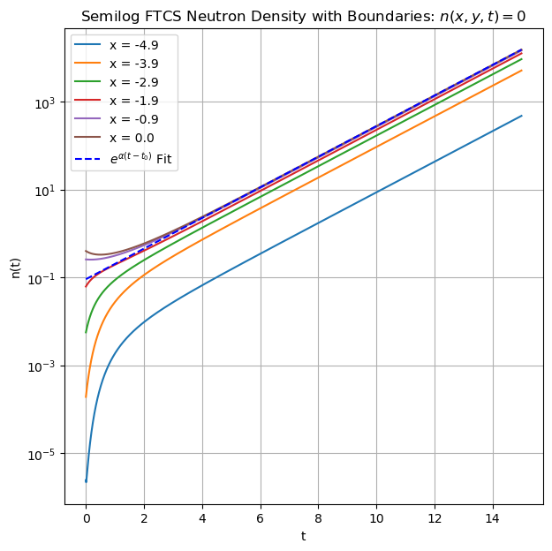
Dirichlet Behavior
Notes:
Distribution is as expected from analytical calcs
Initially, the density drops for points near the center as the gaussian diffuses, while it rises much faster than exponentially around the edges as density diffuses into those regions.
Trajectories are split, as they are sampled from what tends towards a cosine peak.
Growth rate is as predicted by analytical calculuations.

Slide 9
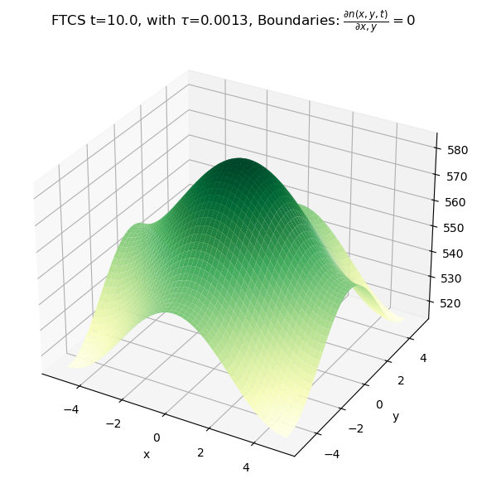
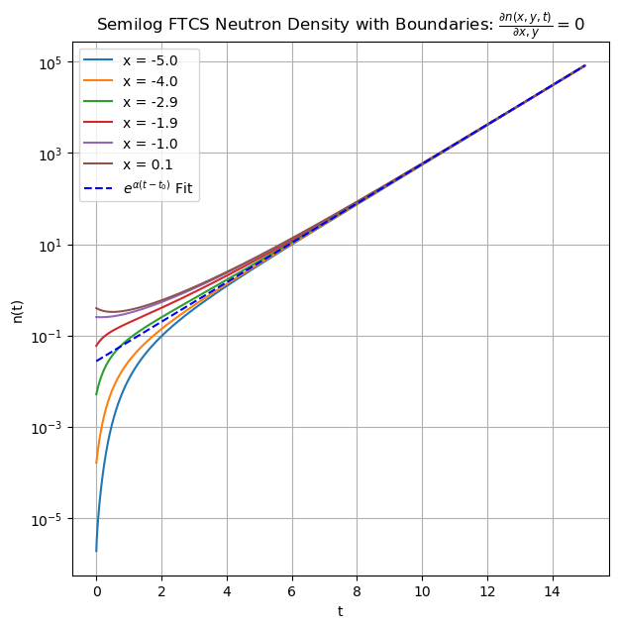
Neumann Behavior
Notes:
Similar early-time qualitative behavior.
Paths converge as the distribution flattens and relative amplitudes become very similar, even as absolute difference between highest and lowest points increase.
Slower convergence as diffusive behavior continues for a long time, and does not seem to fully end.
Growth rate is as predicted by analytical calculuations.

Slide 10


Slide 11


Slide 12
Conclusion
FTCS and LAX methods both work well.
Fourier methods would help clarify behavior for Neumann boundary conditions.

Slide 13
References
Alejandro L. Garcia. Numerical Methods for Physics (Python). (CreateSpace Independent Publishing, 2017).
Stacey, W. M. Nuclear Reactor Physics. (Wiley-VCH, 2007).
Lewis, E. E. Fundamentals of Nuclear Reactor Physics. (Elsevier, 2008).
Noh, T. A Study on Diffusion Approximations to Neutron Transport Boundary Conditions. J. of Nucl. Fuel Cycle and waste Technol. 16, 203–209 (2018).
Moin, P. Fundamentals of engineering numerical analysis. (Cambridge University Press, 2010).
Ali, A. H. et al. A Comparison of Finite Difference and Finite Volume Methods with Numerical Simulations: Burgers Equation Model. Complexity 2022, e9367638 (2022).

